Slide 1
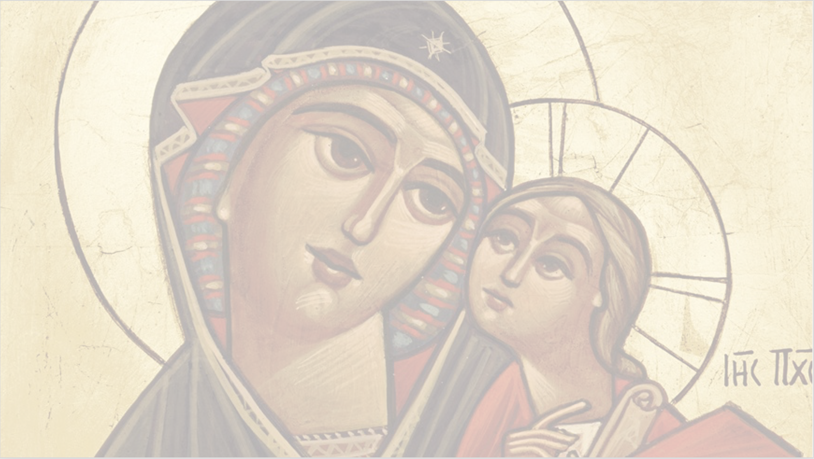
Vespers Doxology for the Virgin
The adornment of Mary,
in the highest heaven,
at the right hand of her beloved,
entreating him on our behalf.

Slide 2
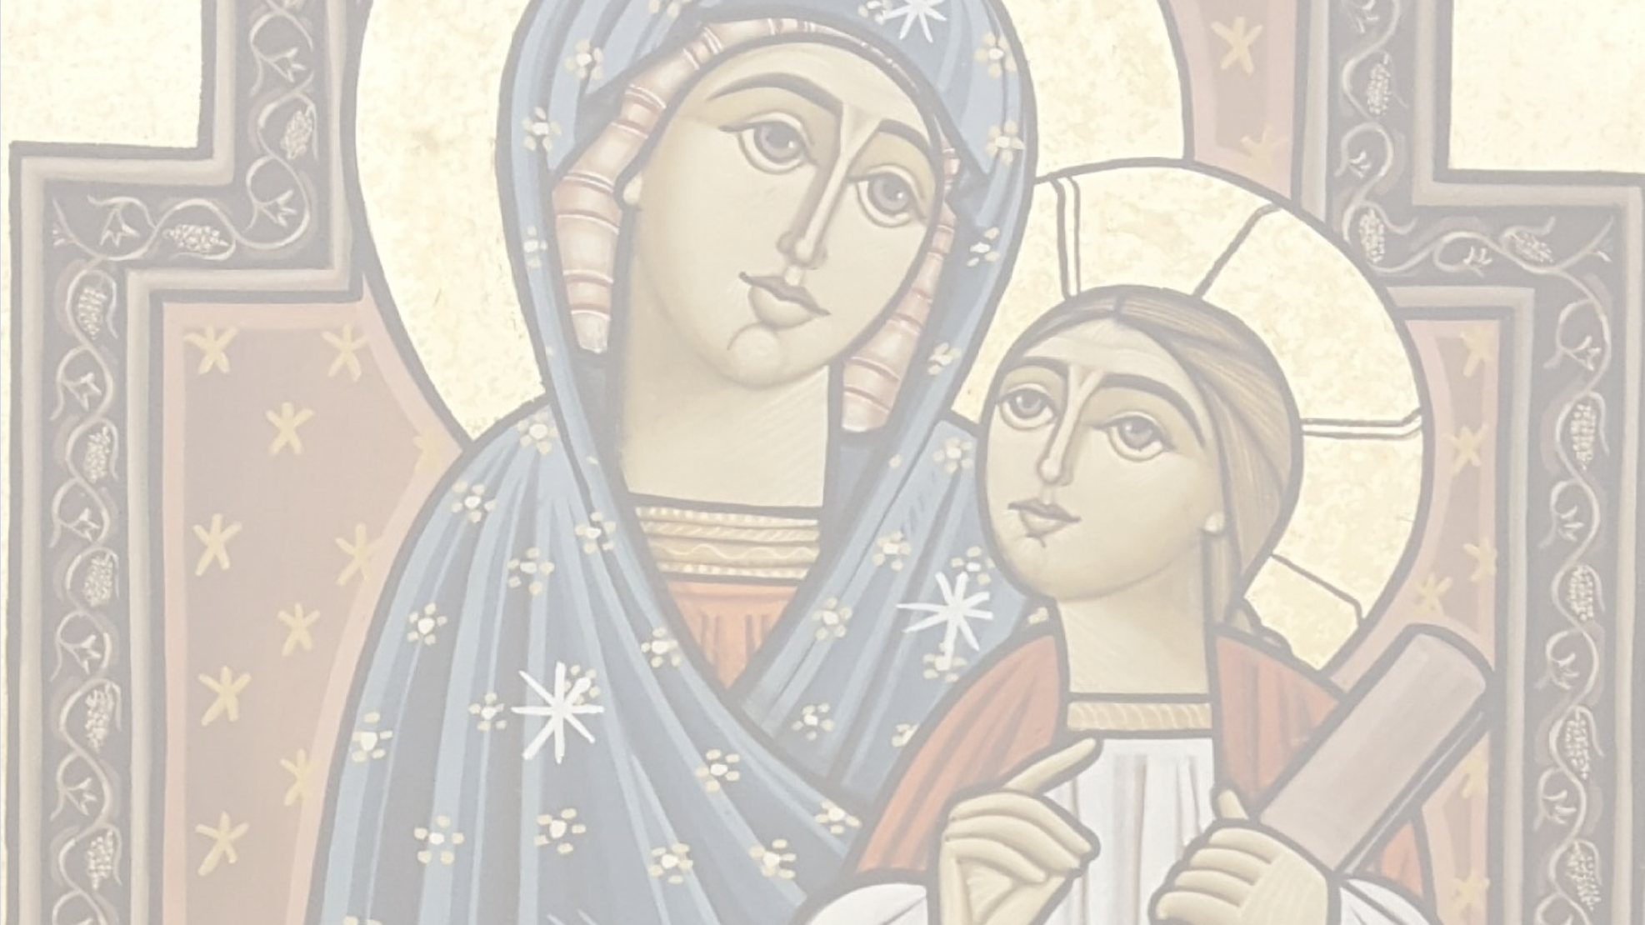
Vespers Doxology for the Virgin
As David has said,
in the book of Psalms
“The Queen stood at
Your right hand, O King.”
Notes:
Reference from Psalm 45:9

Slide 3
Vespers Doxology for the Virgin
Solomon has called her
in the Song of Songs
“My sister and my spouse,
My true city Jerusalem.”

Slide 4
Vespers Doxology for the Virgin
For He has given a symbol of her
in many high names saying,
“Come out of your garden,
O Choicest aroma.”
Notes:
Reference from Song of Songs 4:16

Slide 5
Vespers Doxology for the Virgin
Hail to you O Virgin,
The right and true queen,
Hail to the pride of our race,
Who bore to us Immanuel.

Slide 6
Vespers Doxology for the Virgin
We ask you to remember us,
O our faithful advocate,
before our Lord Jesus Christ,
that He may forgive us our sins.

Slide 7
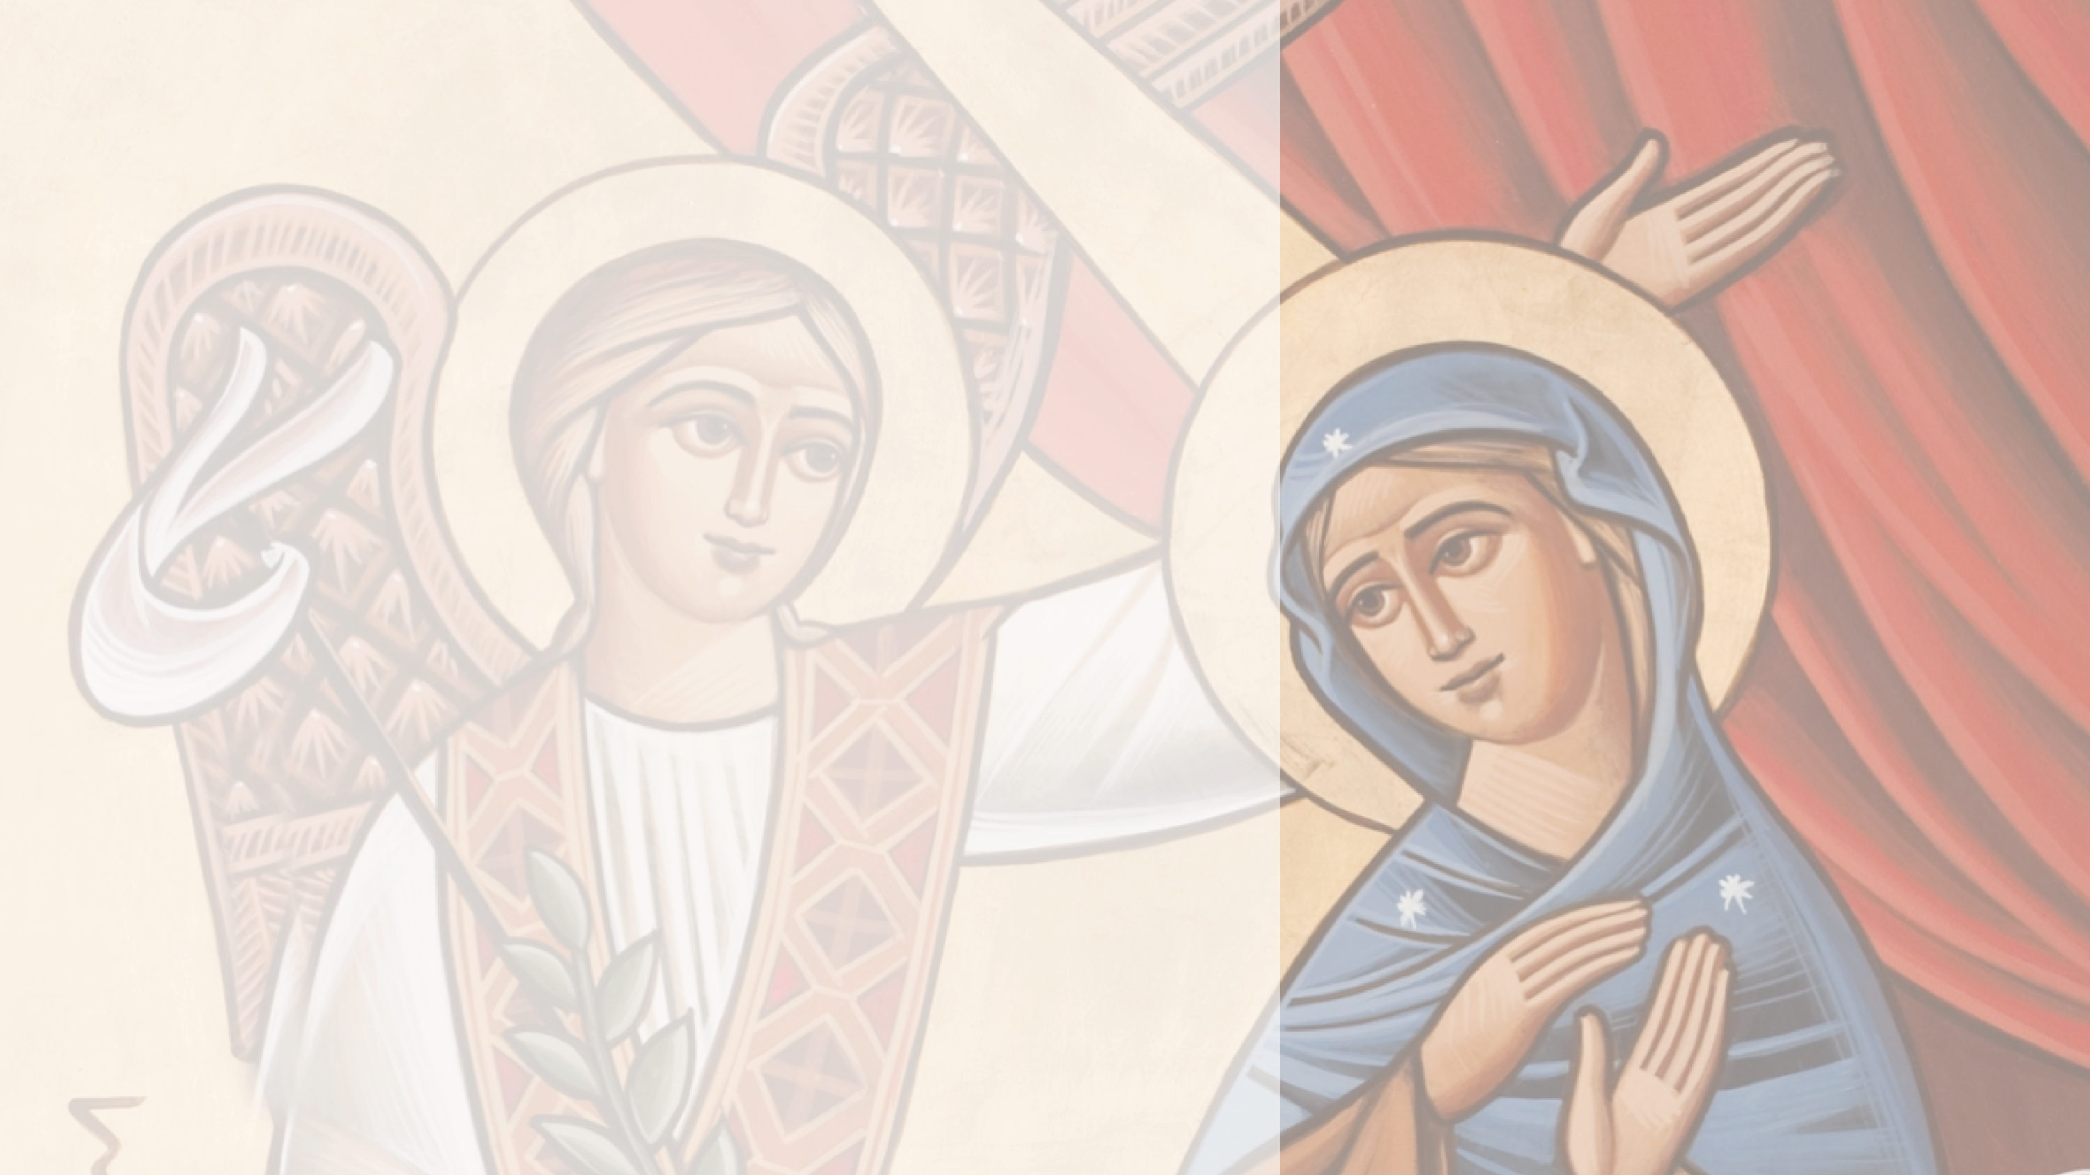
Doxology for All the Heavenly Beings
Seven archangels,
praising as they stand,
before the Pantocrator,
serving the hidden Mystery.

Slide 8
Doxology for All the Heavenly Beings
Michael is the first,
Gabriel is the second,
Raphael is the third,
a symbol of the Trinity.

Slide 9
Doxology for All the Heavenly Beings
Suriel, Sedakiel,
Sarathiel, and Ananiel,
the great and holy luminaries,
entreating Him for the creation.

Slide 10
Doxology for All the Heavenly Beings
The cherubim and the seraphim,
the thrones, dominions, and powers,
the four incorporeal creatures,
carrying the throne of God.

Slide 11
Doxology for All the Heavenly Beings
The twenty-four presbyters,
in the Church of the first-born,
praising Him without ceasing,
proclaiming and saying,

Slide 12
Doxology for All the Heavenly Beings
“Holy God,
heal the sick,
Holy Mighty,
O Lord repose those who are asleep.

Slide 13
Doxology for All the Heavenly Beings
Holy Immortal,
bless Your inheritance,
may Your mercy and peace,
be a fortress to Your people.

Slide 14
Doxology for All the Heavenly Beings
Holy, Holy,
Holy, O Lord of hosts,
heaven and earth are full of,
Your glory and honor.

Slide 15
Doxology for All the Heavenly Beings
And when they say, "Alleluia”,
the heavenly respond saying,
"Holy, Amen. Alleluia,
Glory be to our God."

Slide 16
Doxology for All the Heavenly Beings
Intercede on our behalf,
O angelic armies,
and heavenly orders,
that He may forgive us our sins.

Slide 17
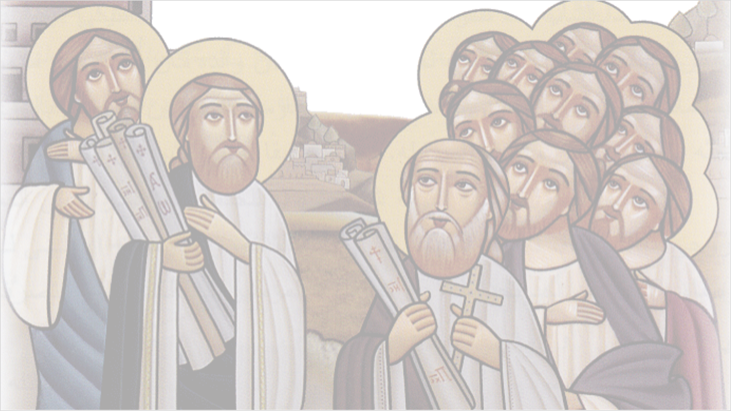
Doxology for the Apostles
Our Lord Jesus Christ,
has chosen His apostles,
Peter and Andrew,
John and James.

Slide 18
Doxology for the Apostles
Also, Philip and Matthew,
Bartholomew and Thomas,
James the son of Alphaeus,
and Simon the Canaanite.

Slide 19
Doxology for the Apostles
Thaddaeus and Matthias,
Paul, Mark and Luke,
and the rest of the disciples,
who followed our Savior.

Slide 20
Doxology for the Apostles
Matthias, who was chosen,
in place of Judas,
all of them and the rest,
followed the Master.

Slide 21
Doxology for the Apostles
Their voices went forth,
throughout the face of the whole earth,
and their words have reached,
the ends of the world.

Slide 22
Doxology for the Apostles
Pray to the Lord on our behalf,
O my lords and fathers the apostles,
and the seventy-two disciples,
that He may forgive us our sins.

